Slide 1
Boundary value analysis
Programs often fail on special values
These values often lie on boundary of equivalence classes
Test cases that have boundary values have high yield
These are also called extreme cases
A BV test case is a set of input data that lies on the edge of a eq class of input/output
Testing

Slide 2
Boundary value analysis
Programmers may improperly use < instead of <=
Testing

Slide 3
BVA...
For each equivalence class
  choose values on the edges of the class
  choose values just outside the edges
E.g. if 0 <= x <= 1.0
  0.0 , 1.0 are edges inside
  -0.1,1.1 are just outside
E.g. a bounded list - have a null list , a maximum value list
Consider outputs also and have test cases generate outputs on the boundary
Testing

Slide 4
BVA…
In BVA we determine the value of vars that should be used
If input is a defined range, then there are 6 boundary values plus 1 normal value (tot: 7)
If multiple inputs, how to combine them into test cases; two strategies possible
  Try all possible combination of BV of diff variables, with n vars this will have 7^{n} test cases!
  Select BV for one var; have other vars at normal values + 1 of all normal values
Testing

Slide 5
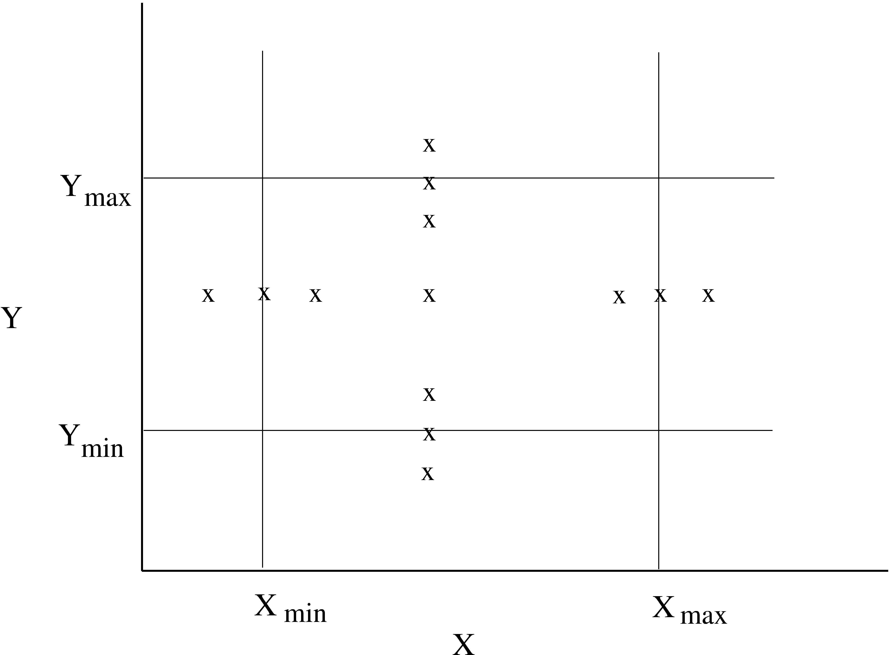
BVA.. (test cases for two vars – x and y)
Testing

Slide 6
Pair-wise testing
Often many parmeters determine the behavior of a software system
The parameters may be inputs or settings, and take diff values (or diff value ranges)
Many defects involve one condition (single-mode fault), eg. sw not being able to print on some type of printer
  Single mode faults can be detected by testing for different values of diff parms
  If n parms and each can take m values, we can test for one diff value for each parm in each test case
  Total test cases: m
Testing

Slide 7
Pair-wise testing…
All faults are not single-mode and sw may fail at some combinations
  Eg tel billing sw does not compute correct bill for night time calling (one parm) to a particular country (another parm)
  Eg ticketing system fails to book a biz class ticket (a parm) for a child (a parm)
Multi-modal faults can be revealed by testing diff combination of parm values
This is called combinatorial testing
Testing

Slide 8
Pair-wise testing…
Full combinatorial testing not feasible
  For n parms each with m values, total combinations are n^{m}
  For 5 parms, 5 values each (tot: 3125), if one test is 5 mts, tot time > 1 month!
Research suggests that most such faults are revealed by interaction of a pair of values
I.e. most faults tend to be double-mode
For double mode, we need to exercise each pair – called pair-wise testing
Testing

Slide 9
Pair-wise testing…
In pair-wise, all pairs of values have to be exercised in testing
If n parms with m values each, between any 2 parms we have m*m pairs
  1st parm will have m*m with n-1 others
  2nd parm will have m*m pairs with n-2
  3rd parm will have m*m pairs with n-3, etc.
  Total no of pairs are m*m*n*(n-1)/2
Testing

Slide 10
Pair-wise testing…
A test case consists of some setting of the n parameters
Smallest set of test cases when each pair is covered once only
A test case can cover a maximum of (n-1)+(n-2)+…=n(n-1)/2 pairs
In the best case when each pair is covered exactly once, we will have m² different test cases providing the full pair-wise coverage
Testing

Slide 11
Pair-wise testing…
Generating the smallest set of test cases that will provide pair-wise coverage is non-trivial
Efficient algos exist; efficiently generating these test cases can reduce testing effort considerably
  In an example with 13 parms each with 3 values pair-wise coverage can be done with 15 testcases
Pair-wise testing is a practical approach that is widely used in industry
Testing

Slide 12
Pair-wise testing, Example
A sw product for multiple platforms and uses browser as the interface, and is to work with diff OSs
We have these parms and values
  OS (parm A): Windows, Solaris, Linux
  Mem size (B): 128M, 256M, 512M
  Browser (C): IE, Netscape, Mozilla
Total no of pair wise combinations: 27
No of cases can be less
Testing

Slide 13
Pair-wise testing…
Test case | Pairs covered
a1, b1, c1 a1, b2, c2 a1, b3, c3 a2, b1, c2 a2, b2, c3 a2, b3, c1 a3, b1, c3 a3, b2, c1 a3, b3, c2 | (a1,b1) (a1, c1) (b1,c1) (a1,b2) (a1,c2) (b2,c2) (a1,b3) (a1,c3) (b3,c3) (a2,b1) (a2,c2) (b1,c2) (a2,b2) (a2,c3) (b2,c3) (a2,b3) (a2,c1) (b3,c1) (a3,b1) (a3,c3) (b1,c3) (a3,b2) (a3,c1) (b2,c1) (a3,b3) (a3,c2) (b3,c2)
Testing

Slide 14
Special cases
Programs often fail on special cases
These depend on nature of inputs, types of data structures, etc.
No good rules to identify them
One way is to guess when the software might fail and create those test cases
Also called error guessing
Play the sadist & hit where it might hurt
Testing

Slide 15
Error Guessing
Use experience and judgement to guess situations where a programmer might make mistakes
Special cases can arise due to assumptions about inputs, user, operating environment, business, etc.
E.g. A program to count frequency of words
  file empty, file non existent, file only has blanks, contains only one word, all words are same, multiple consecutive blank lines, multiple blanks between words, blanks at the start, words in sorted order, blanks at end of file, etc.
Perhaps the most widely used in practice
Testing

Slide 16
State-based Testing
Some systems are state-less: for same inputs, same behavior is exhibited
Many systems’ behavior depends on the state of the system i.e. for the same input the behavior could be different
I.e. behavior and output depend on the input as well as the system state
System state – represents the cumulative impact of all past inputs
State-based testing is for such systems
Testing

Slide 17
State-based Testing…
A system can be modeled as a state machine
The state space may be too large (is a cross product of all domains of vars)
The state space can be partitioned in a few states, each representing a logical state of interest of the system
State model is generally built from such states
Testing

Slide 18
State-based Testing…
A state model has four components
  States: Logical states representing cumulative impact of past inputs to system
  Transitions: How state changes in response to some events
  Events: Inputs to the system
  Actions: The outputs for the events
Testing

Slide 19
State-based Testing…
State model shows what transitions occur and what actions are performed
Often state model is built from the specifications or requirements
The key challenge is to identify states from the specs/requirements which capture the key properties but is small enough for modeling
Testing

Slide 20
When the tester is trying to test sequence of events that occur in the application under test. I.e., this will allow the tester to test the application behavior for a sequence of input values.
When the system under test has a dependency on the events/values in the past.
Testing

Slide 21
When to Not Rely On State Transition
When the testing is not done for sequential input combinations.
If the testing is to be done for different functionalities like exploratory testing
Testing

Slide 22
State-based Testing…
State model can be created from the specs or the design
For objects, state models are often built during the design process
Test cases can be selected from the state model and later used to test an implementation
Many criteria possible for test cases
Testing

Slide 23
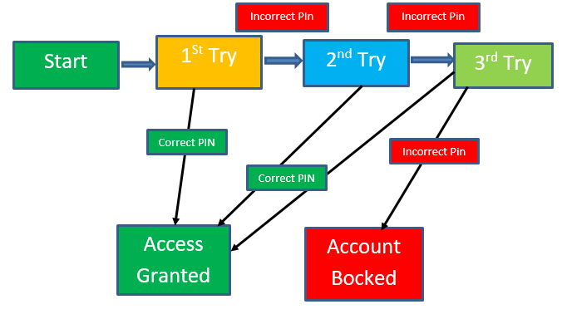
State Transition Diagram
Testing

Slide 24
State Transition Table
 | Correct PIN | Incorrect PIN
S1) Start | S5 | S2
S2) 1st attempt | S5 | S3
S3) 2nd attempt | S5 | S4
S4) 3rd attempt | S5 | S6
S5) Access Granted | - | -
S6) Account blocked | - | -
Testing

Slide 25
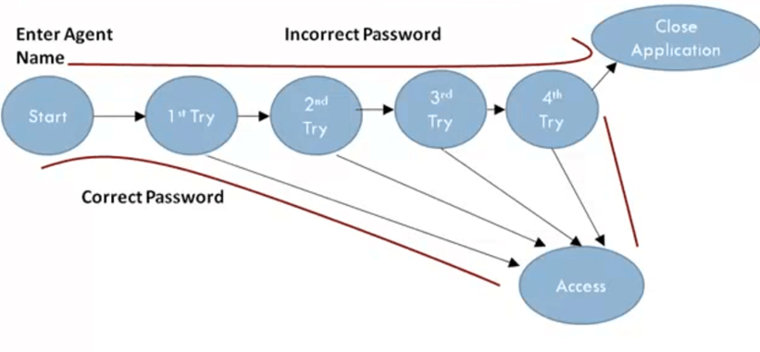
State Transition graph
Testing

Slide 26
State-based Testing criteria
All transaction coverage (AT): test case set T must ensure that every transition is exercised
All transitions pair coverage (ATP). T must execute all pairs of adjacent transitions (incoming and outgoing transition in a state)
Transition tree coverage (TT). T must execute all simple paths (i.e. a path from start to end or a state it has visited)
Testing

Slide 27
State-based testing…
SB testing focuses on testing the states and transitions to/from them
Different system scenarios get tested; some easy to overlook otherwise
State model is often done after design information is available
Hence it is sometimes called grey box testing (as it not pure black box)
Testing

